Slide 1
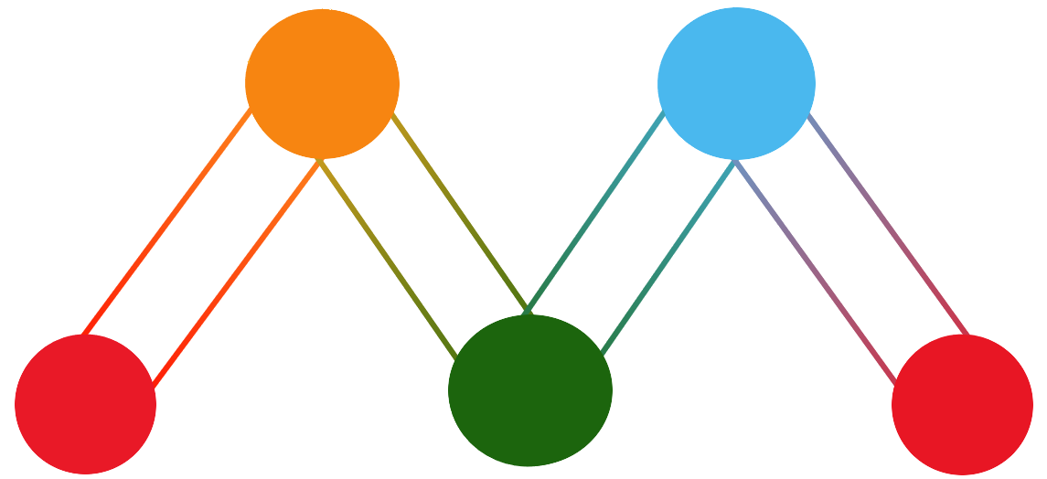
Milestone
School focused Personal Planner Application

Slide 2
Who are we?
3JN Software Development Team
Jordan Mower
Jordan Nienaber
Jonathan Hua
Nick Luckey

Slide 3
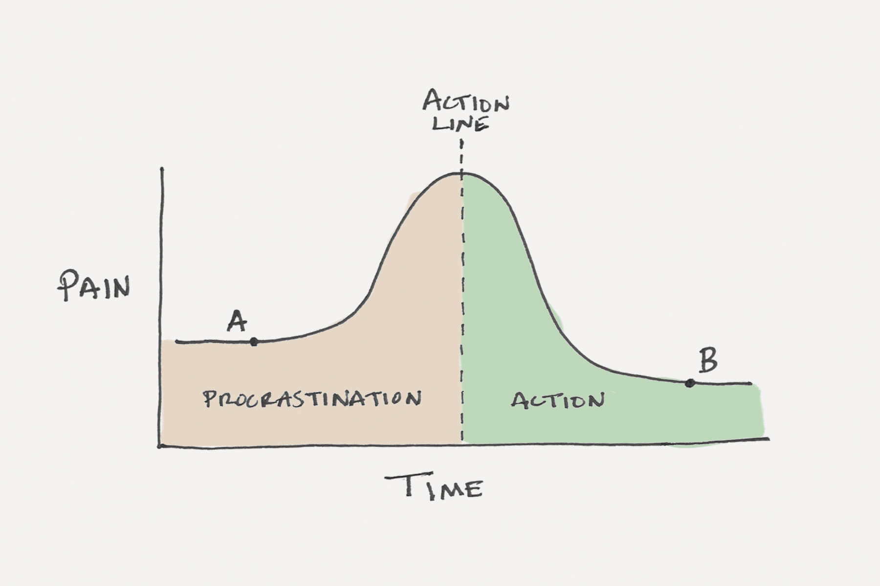
Why are we building this?
20% of US adults are chronic procrastinators
2007 study: 80-95% college students procrastinate regularly
4 of the top 15 reasons for procrastination include:
Not knowing what needs to be done
Delaying a task in favor of working on another
Forgetting
Needing time to think about the task
2007 mental health study:
Procrastinators had less stress in beginnings of terms
Procrastinators had DRASTICALLY more stress to end terms
(statistics/study from Joseph Ferrari, professor of psychology at UChicago)

Slide 4
What will it accomplish? Who will it help?
*The production of Milestone will provide students with the ability to manage coursework loads and collaborate with peers through shareable coursework calendars.*
Manage “tasks” assigned
CRUD tasks within a calendar
Tasks organized by course title/colors
Mark tasks as completed
Set priority for tasks
Import peers’ calendars
----------------------------------------------------------------------------------------------------------------------------------------------------
Intended users: student enrolled in a course or several courses
Average user will be an undergraduate student enrolled in several courses
Development for Android only

Slide 5
Functional Requirements (Login & Registration)
Use Case Name | 3.2.1.2 Log In
Goal | Log a user into the application using their registered credentials.
Primary Actor | User
Preconditions | 3.2.1.1
Postconditions | The user will be logged in to the application
MSS | User enters username User enters password User presses Log In User is logged in to the application
Extension 1 | 3a. User enters an incorrect username or password 3a1. User is asked to reenter their username or password. 3a2. Start back at MSS 3.
Use Case Name | 3.2.1.1 Registration
Goal | Allow an unregistered user to create an account
Primary Actor | User
Preconditions | The user must have a smartphone and the application downloaded.
Postconditions | The user will be enrolled in the system with the username and information provided.
MSS | User enters username, password, password confirmation, DoB, School, Grade/year User presses submit/login User is enrolled in database User is logged in
Extension 1 | 1a. User incorrectly matches password and password confirmation. 1a1. User is alerted to error with password matching and asked to reconfirm. 1b. User uses invalid characters in one of the provided fields. 1b1. The user is alerted to the invalid entry and asked to reenter.
Extension 3 | 2a. User fails to fill in all fields 2a. User is alerted to missing fields and asked to fill them in. 2b. Username is taken 2b1. User is alerted that username is taken and asked to change to something else.

Slide 6
Functional Requirements (Tasks)
Use Case Name | 3.2.1.8 View Task
Goal | User views tasks for a specific date
Primary Actor | User
Preconditions | 3.2.1.6 or 3.2.1.10
Postconditions | User is given a view of tasks for the selected date
MSS | User selects a date from the calendar view. System provides a view of all tasks for the selected day if any exist.
Use Case Name | 3.2.1.6 Add Task
Goal | Add a task to the selected course
Primary Actor | User
Preconditions | 3.2.1.3, user is the owner of selected course.
Postconditions | The task is added to the selected course and displayed in planner.
MSS | User navigates to Task Menu User selects the course that they wish to add a task to. User fills in task information. Task is added to course and planner.
Extension 1 | 2a. User selects a course that they are not the creator of. 2a1. User is alerted that they cannot add tasks to courses they didn’t create and are asked to select another course. 2a2. Begin at MSS 2
Extension 2 | 2a. User enters invalid characters into one of the fields.

Slide 7
Functional Requirements (Tasks)
Use Case Name | 3.2.1.10 Complete Task
Goal | Mark a task as completed
Primary Actor | User
Preconditions | 3.2.1.8, task is in the future, user is the owner of the course that the task belongs to
Postconditions | User successfully marked a task as completed or finished
MSS | User selects a date from the calendar view. System populates the task view. User selects the green check on the task he/she wishes to mark as completed. System will mark the specified task as completed and it is greyed out on the calendar view and task view.
Extension 1 | 2a. No task for the date. 2a1. User is shown an empty view.
Extension 2 | 3a. User selects a task they do not own. 3a1. System alerts the user that the task cannot be marked with completion because they don’t own it.
Use Case Name | 3.2.1.9 Delete Task
Goal | Delete a task from the course
Primary Actor | User
Preconditions | 3.2.1.6 or 3.2.1.10, and user is owner of selected course, task is in the future
Postconditions | User successfully deleted a task from their course.
MSS | User selects a date from the calendar view. System populates task view User selects “X” on the task they wish to delete System deletes the task from their course and updates planner.
Extension 1 | 2a. No tasks to display for selected date. 2a1. User is shown an empty task view.
Extension 2 | 3a. User selects a task they do not own. 3a1. System alerts the user that the task cannot be deleted because they don’t own it.

Slide 8
Functional Requirements (Courses)
Use Case Name | 3.2.1.3 Add Course
Goal | Allow user to add a new course to their planner.
Primary Actor | User
Preconditions | 3.2.1.1, 3.2.1.2
Postconditions | The user has added the course to their planner.
MSS | User enters course name, instructor name, meeting days, and selected a course color The add course button is pressed. The users course is added to their planner.
Extension 1 | 1a. User uses invalid characters in the course name or instructors name 1a1. The system alerts the user there is incorrect information 1a2. The user fixes error
Extension 2 | 2a. The user already has a course with the same course name. 2a1. The user is prompted to change the course name 2a2. Begin at MSS 2.
Use Case Name | 3.2.1.4 Delete Course
Goal | User deletes selected course
Primary Actor | User
Preconditions | User has navigated to course menu. 3.2.1.3, Or user has subscribed to another users course
Postconditions | The selected course is deleted/unsubscribed from the users planner.
MSS | User selects a course User presses delete course button System deletes course information from users planner and/or unsubscribes them from other users course.

Slide 9
Functional Requirements (Courses)
Use Case Name | 3.2.1.5 Edit Course
Goal | User edits course information
Primary Actor | User
Preconditions | 3.2.1.3, and course being edited was created by the user.
Postconditions | Course information is successfully edited and saved.
MSS | User selects a course from the course menu. User selects edit course from course menu. System populates the course fields User edits a field from the add course screen. User presses add course The edited course is saved and uploaded.
Extension 1 | 2a. The selected course from the course menu was not created by the user and can not be edited.

Slide 10
Functional Requirements (Subscribe & Search)
Use Case Name | 3.2.1.11 Subscribe to Course
Goal | User successfully subscribes to another users course.
Primary Actor | User
Preconditions | User is not already subscribed to this course and 3.2.1.12
Postconditions | User will be subscribed to the new course and the planner will be updated.
MSS | User presses subscribe button on the course that they wish to subscribe to. User is asked to confirm subscription Subscription is confirmed and users calendar is updated with subscribed courses information.
Extension 1 | 2a. User already has a course with the subscribed courses name. 2a1. System asks user if they wish to overwrite the already existing courses information. 2a2. User confirms and data is overwritten or user cancels and subscription is aborted.
Use Case Name | 3.2.1.12 Search for Courses
Goal | User is able to search for courses that they specify by keyword.
Primary Actor | User
Preconditions | User has navigated to search function. Other users have added courses.
Postconditions | User will be presented a list of courses to subscribe to.
MSS | User navigates to search menu User types in a keyword or phrase to be searched. System populates the window with relevant results
Extension 1 | 2a. User enters invalid characters into search bar. 2a1. System will return no results.
Extension 2 | 3a. System finds no results matching search criteria 3a1. System reports that no search results were found.

Slide 11
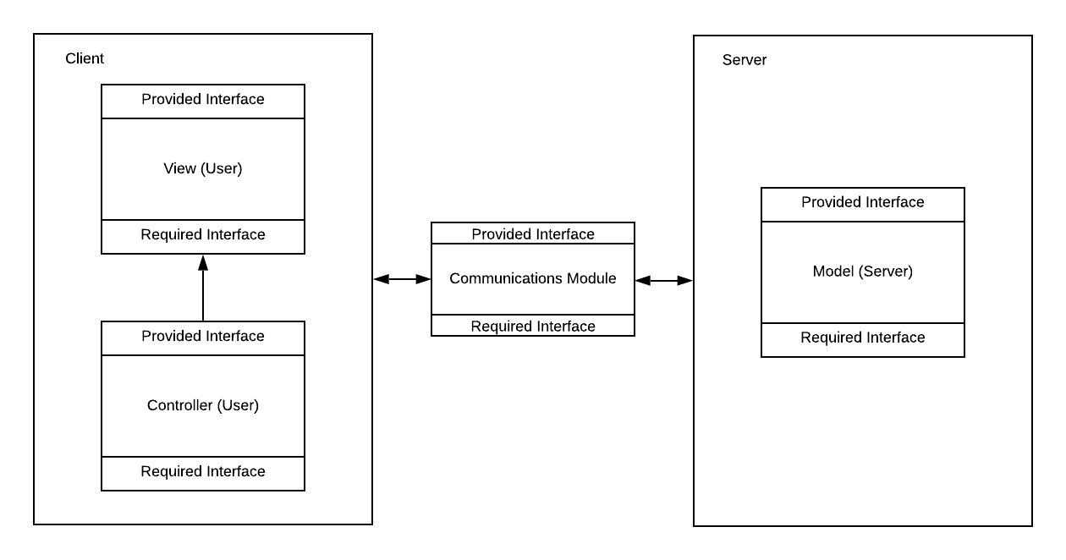
High Level Architecture
Model-View-Controller
Key Advantages:
Less models = less controllers
Separation of concerns
Proper MVVM can be overkill for simple applications

Slide 12
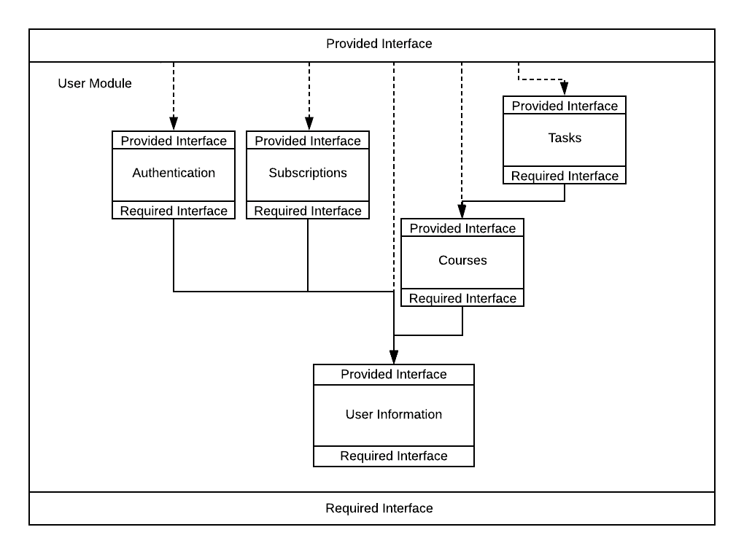
Server - User Module
User
Provided interfaces are the union of:
Tasks
Authentication
Subscriptions
Courses
user information.

Slide 13
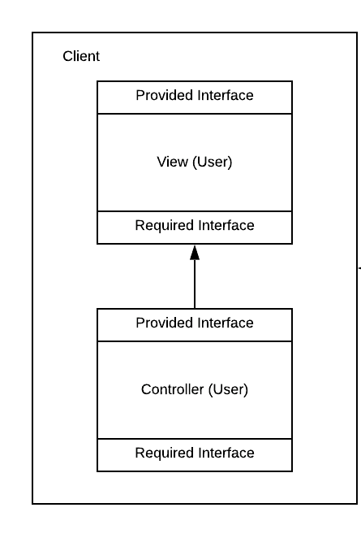
Client
View (Android Device/User)
Controls Display
Controller (Android Device/User)
Business/App Logic
Graphical Display
User Inputs

Slide 14
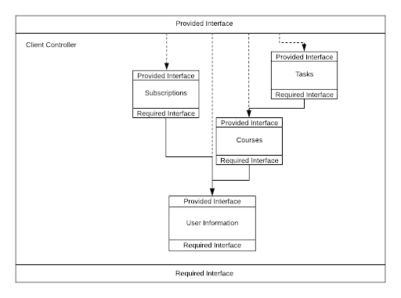
Client Controller Module
- This module is created to relieve the view of having to process both data manipulation and presentation.

Slide 15
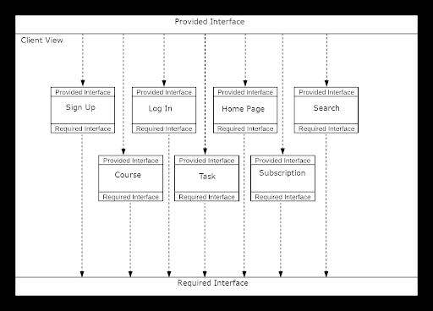
Client View Module
- This module is created so that the presentation is independent of the business logic and the handling of user-input events.

Slide 16
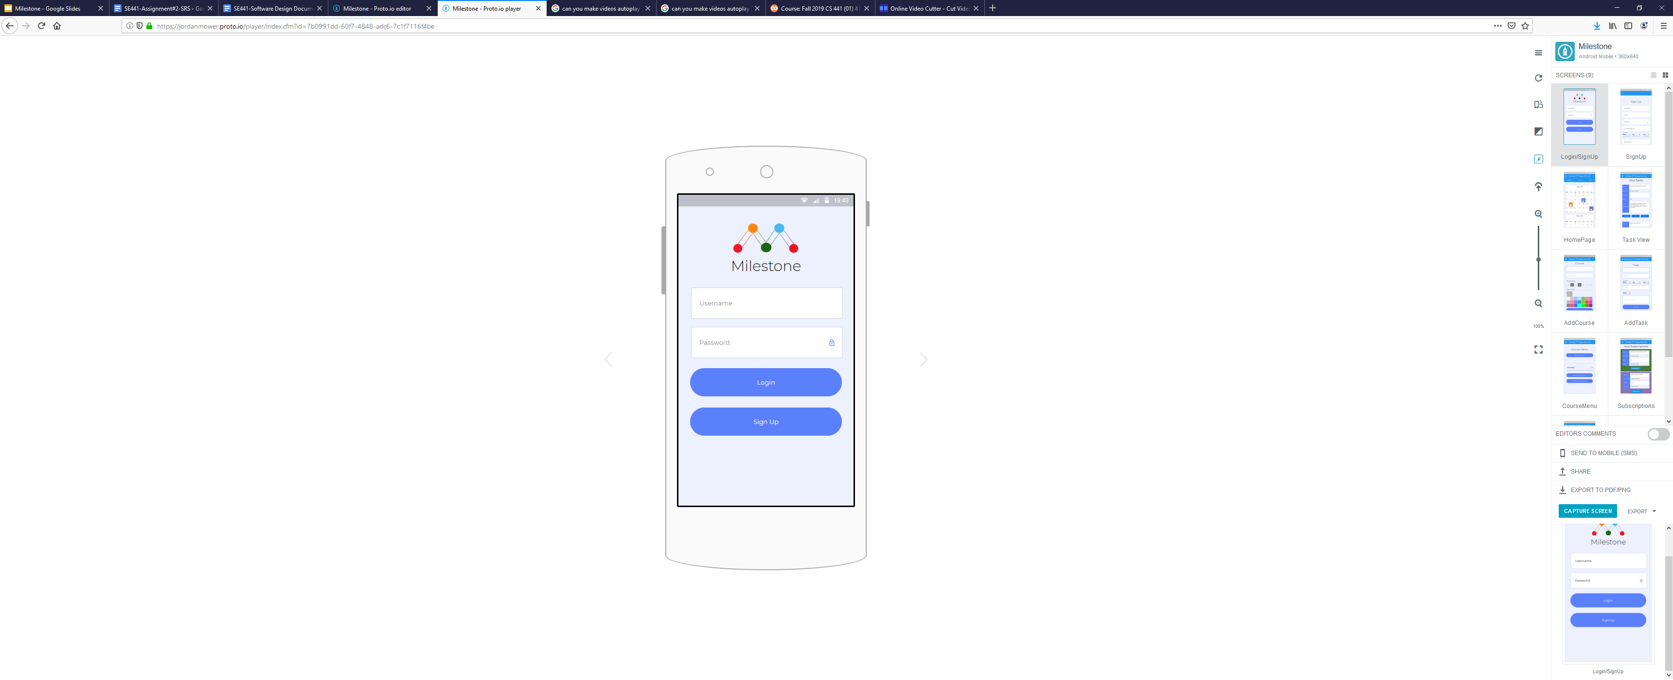
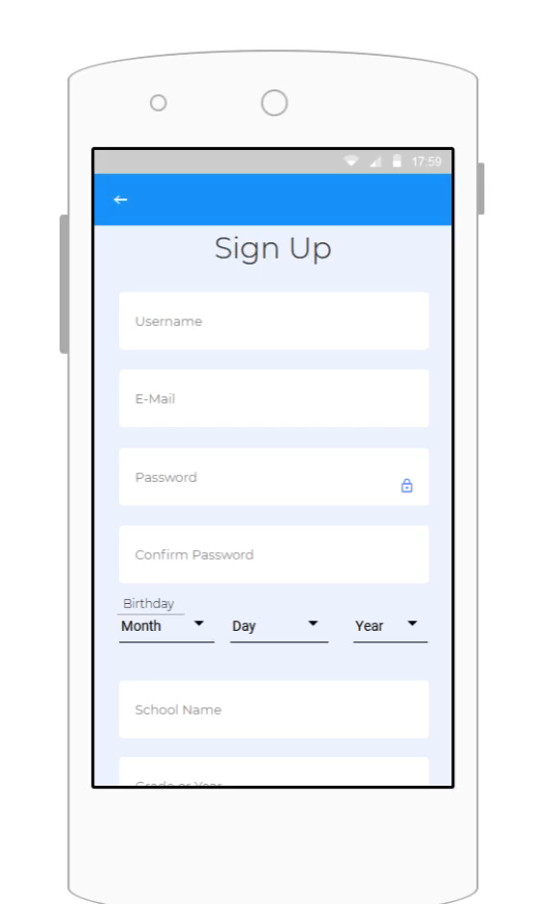
Prototypes
Login
Sign Up

Slide 17
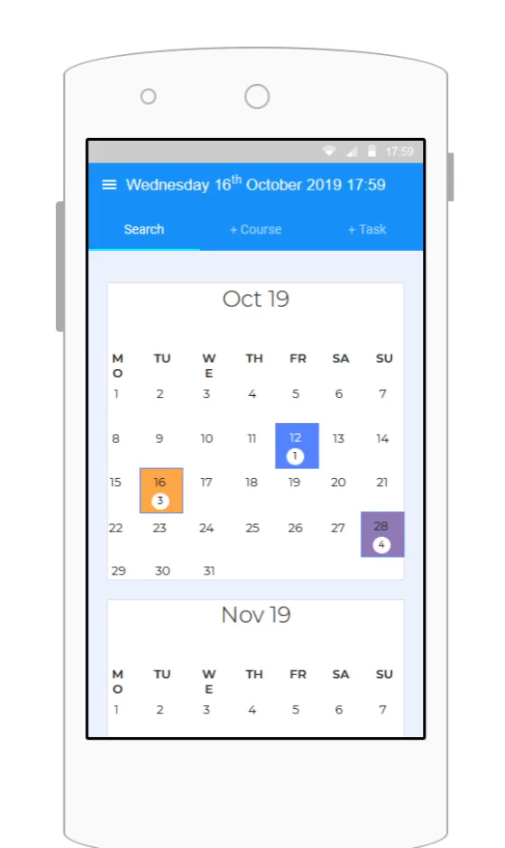
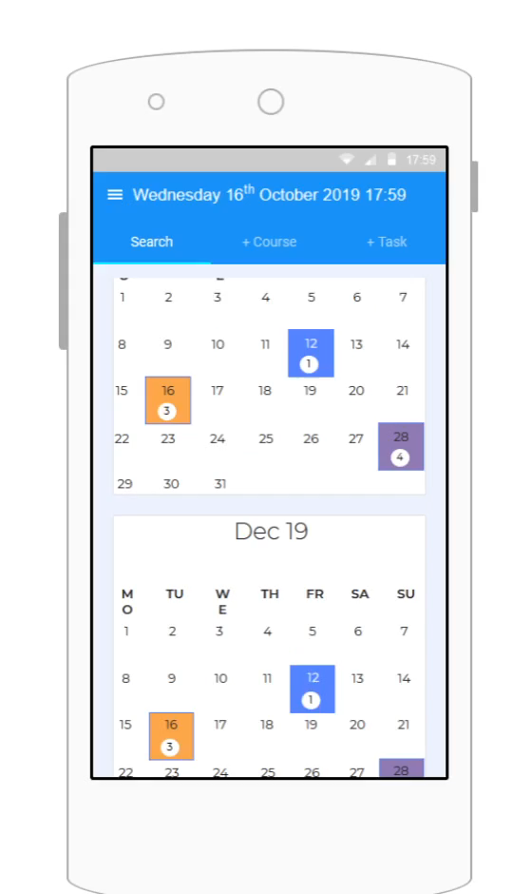
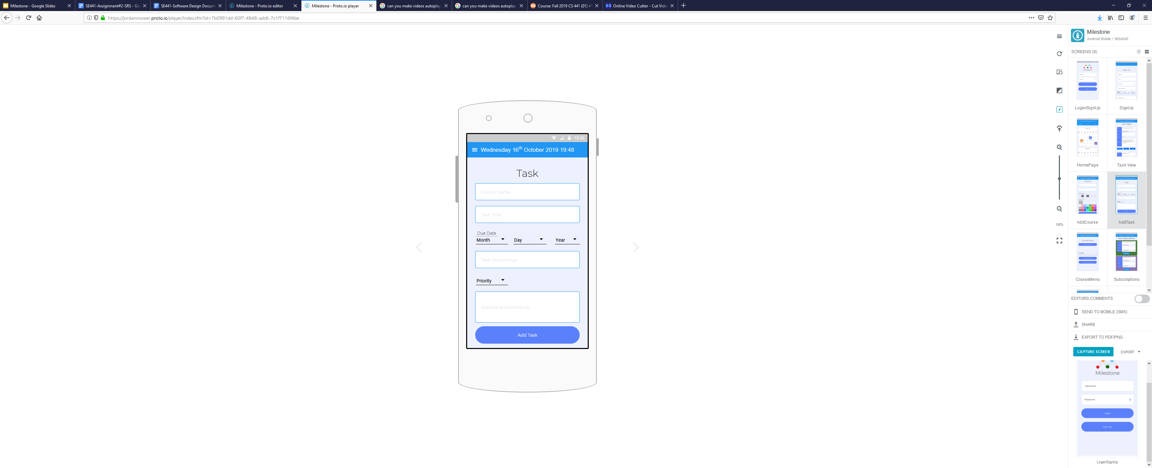
Prototypes
Home Page
Add Task
View Tasks

Slide 18
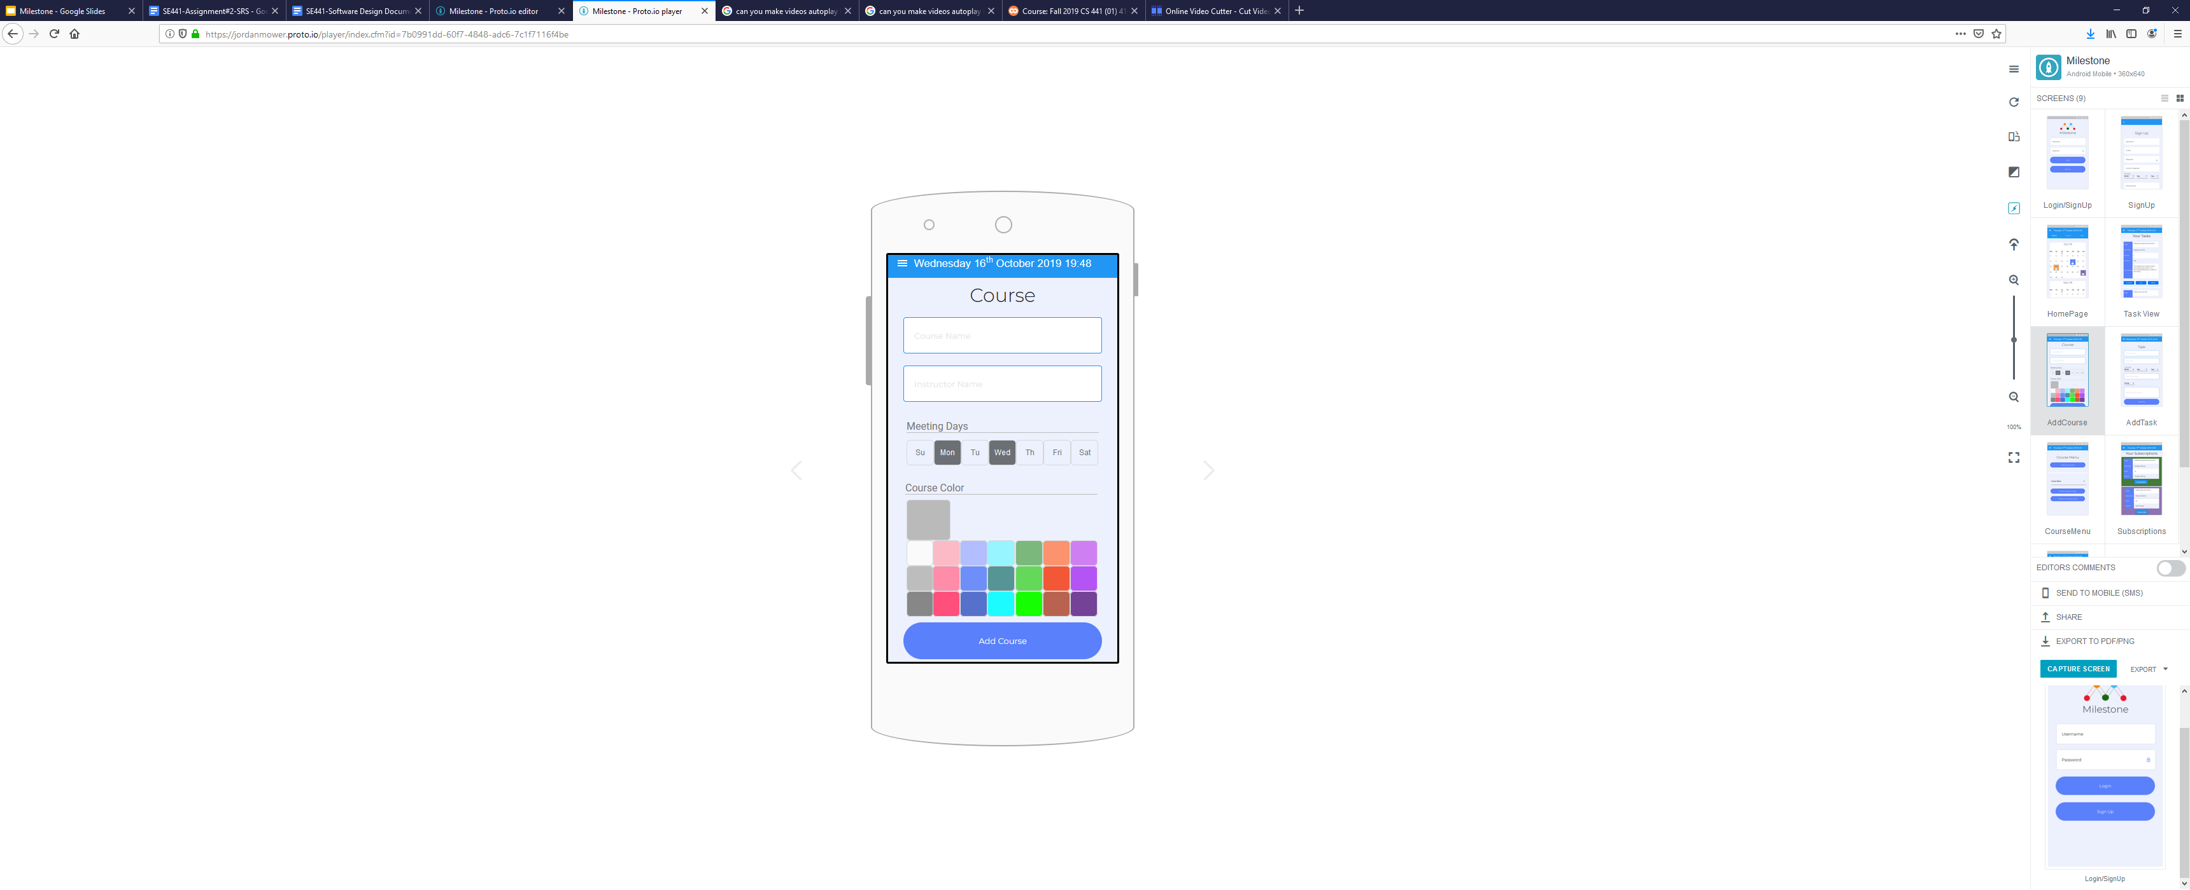
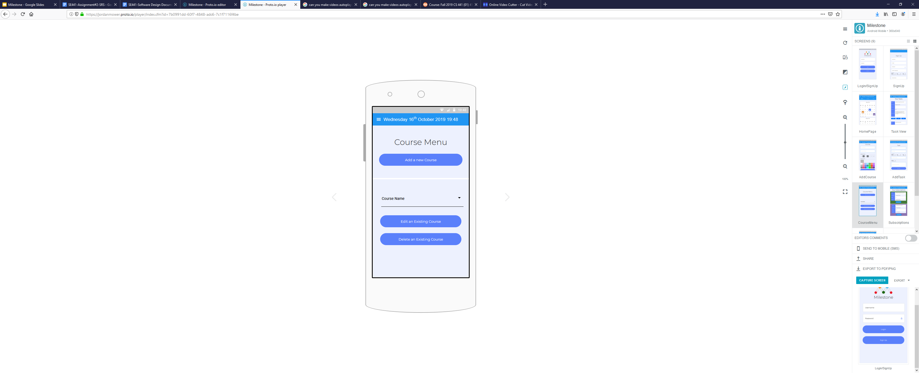
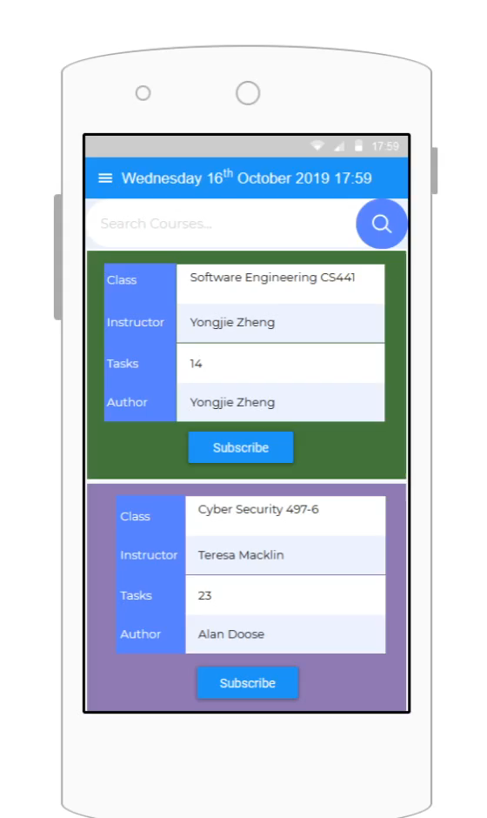
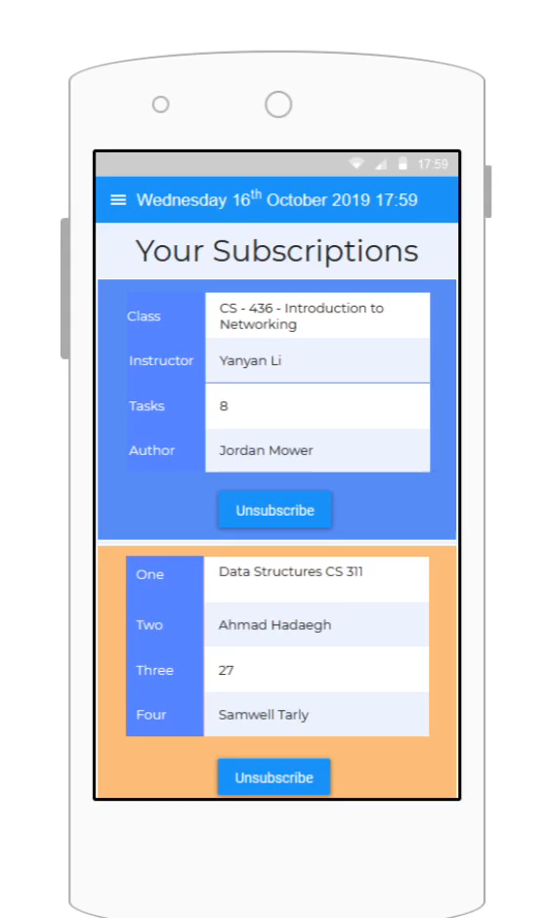
Prototypes
Add Course
Course Menu
Search Courses
Manage Subscriptions

Slide 19
Tools, Frameworks
AWS Amplify Framework
DynamoDB
NoSQL
- Cognito User Pools
Android Studio or Eclipse IDE

Slide 20
Thank You!

